Slide 1
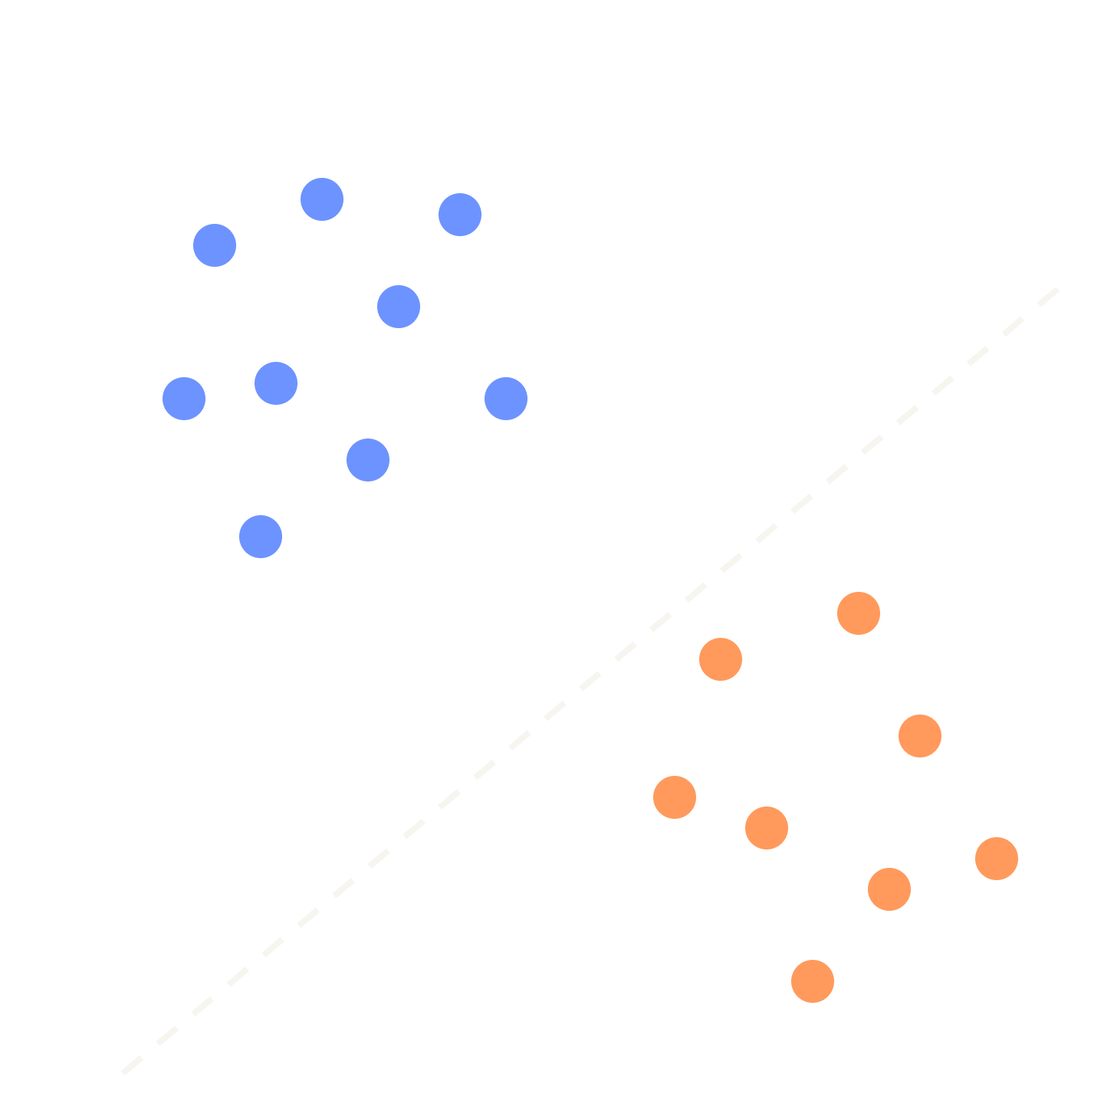
CS-412
Machine Learning
[Bedirhan Kırtan - TA
[Ahmet Emre Küçükatay - TA
Notes:
~1 min. Welcome, add-drop week. Say who you are and what today is: the big picture of ML, the vocabulary you will hear all semester, and one simple algorithm (kNN) that we will code together. No prior ML knowledge is assumed. Plan: about 25 min of slides, then about 15 min of live code, then a short recap.

Slide 2
How would you write the rules for “this is a cat”?
Ears?
Whiskers?
Fur color?
Camera angle?
Lighting?
Half hidden?
Notes:
~1 min. Purpose of this slide: (1) wake the room up with a question anyone can answer; (2) show that hand-written rules break on messy real-world inputs, which is the whole reason ML exists; (3) plant the idea that a photo is just numbers, picked up again on the “image is a list of numbers” slide and in your lecturer’s cat vs. dog and MNIST examples. If you are short on time, skip it. Ask the room: how would you write an if/else program that says “cat” for a photo? Take two or three shouts. Every rule they suggest breaks on some photo (ears hidden, dark room, a cat in a box). Punchline: nobody can write these rules by hand, but we can show a program thousands of cat photos and let it find the pattern. That is machine learning.

Slide 3
Machine learning, defined
A program learns if its performance on a task improves with experience.
EXAMPLE: A SPAM FILTER
Task
Experience
Performance
What we want done
The data it learns from
How we score it
“Spam or not?”
Emails people already labeled
% of emails sorted correctly
Definition after T. Mitchell, Machine Learning (1997)
Notes:
~1 min. Read the definition slowly, then map it onto the spam filter: task = classify emails, experience = emails users already marked as spam, performance = fraction classified correctly. Key idea: the three ingredients T, E, P show up in every ML problem. If you can name them, you have framed the problem.

Slide 4

Programming vs. machine learning
CLASSICAL PROGRAMMING · A HUMAN WRITES THE RULES
Rules + Data
Program
Answers
MACHINE LEARNING · THE RULES COME OUT OF THE DATA
Data + Answers
ML algorithm
Rules (Model)
Intro to Machine Learning · Weeks 1–2
Notes:
~1 min. Top row is what you already know: you write the rules, the computer applies them. Bottom row flips it: we give examples with the right answers and the algorithm produces the rules. That output is called the model. Later, “training” just means running the learning algorithm; “prediction” means applying the model to new data.

Slide 5






ML you already use
Spam filter
Recommendations
Translation
Spam or not?
What to watch next?
Text in, text out
Face unlock
Web search
Chatbots
Is this you?
Best results first
Predict the next word
Intro to Machine Learning · Weeks 1–2
Notes:
~30 sec. Quick audience interaction: which of these did you use today? All of them are ML models trained on data. Mention that behind each one is one of the problem types we will name in a few minutes (spam = classification, recommendations = ranking/prediction, etc.). Do not go deep; this slide is just motivation.

Slide 6
Why we need machine learning
Rules are too hard to write
The world keeps changing
Images, speech, language
Spammers adapt, tastes drift
Too much data for humans
One size fits nobody
Millions of rows, thousands of columns
Personalization for every user
Intro to Machine Learning · Weeks 1–2
Notes:
~1 min. Four reasons, one sentence each. (1) We cannot articulate the rules (what makes a face a face?). (2) Rules go stale; a learned model can be retrained on new data. (3) Scale: no human can inspect millions of records. (4) Personalization: one model per user or segment is only feasible when it is learned automatically. Also be honest: ML is not always the right tool. If a simple rule works, use the rule.

Slide 7
Three ways to learn
Supervised
Unsupervised
Reinforcement
Data comes with answers
No answers, find structure
Rewards, trial and error
Predict a price, spot spam
Group similar customers
Game-playing agents, robots
Intro to Machine Learning · Weeks 1–2
Notes:
~1 min. Supervised: every training example comes with the right answer (a teacher). That is where the syllabus starts: regression, classification, features, train/validation, overfitting. Unsupervised: no answers, the algorithm looks for structure; we will touch clustering shortly. Reinforcement: learning from rewards by interacting with an environment; just so they know the term. Your lecturer’s taxonomy also lists semi-supervised learning (a mix of labeled and unlabeled data); one sentence is enough. Say clearly: for the next weeks, supervised learning is the main character.

Slide 8
Anatomy of a dataset
Features (inputs, x)
Label (target, y)
Area (m²) | Rooms | Age (years) | Price (k$)
85 | 2 | 12 | 210
120 | 3 | 5 | 340
60 | 1 | 30 | 130
150 | 4 | 2 | 460
Row = one sample
Column = one feature
Label = what we predict
Toy data for illustration · Intro to Machine Learning · Weeks 1–2
Notes:
~1 min. This is the single most important picture of the day. Your lecturer writes each example as (x, y): x = the features, y = the label, and the model as a function h with prediction ŷ = h(x); the whole table is the training data. Features are the measurable inputs (area, rooms, age). The label is the answer we want to predict (price). Each row is one example, also called a sample or an observation. Supervised learning = learn a function from features to label using rows where the label is known. Mention: in the lab, data will arrive as a table like this (pandas DataFrame). Also, feature quality matters: garbage in, garbage out. Numbers are made up for illustration.

Slide 9
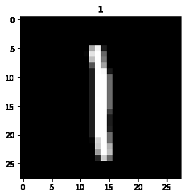
An image is a list of numbers
FLATTEN INTO ONE ROW
[0, 0, 0, 0, 1, 1, 0, 0, …]
784
features per image in MNIST (28 × 28 pixels)
Label y = the digit, 0 to 9
MNIST: handwritten digits
Notes:
~1 min. Connect back to the cat question: a computer does not see a cat, it sees numbers. A grayscale image is a grid of pixel brightness values. Flatten the grid row by row into one long list and every pixel becomes a feature. MNIST, the dataset your lecturer uses in the homeworks, has 28 x 28 = 784 pixels per image and 10 classes (digits 0 to 9). The grid on the slide is a simplified 8 x 8 drawing for illustration; dark = 0 and light = 1 (real data often uses 0 to 255). Takeaway: any data, whether images, emails or houses, can be turned into a feature vector x, and that is what ML algorithms work with.

Slide 10
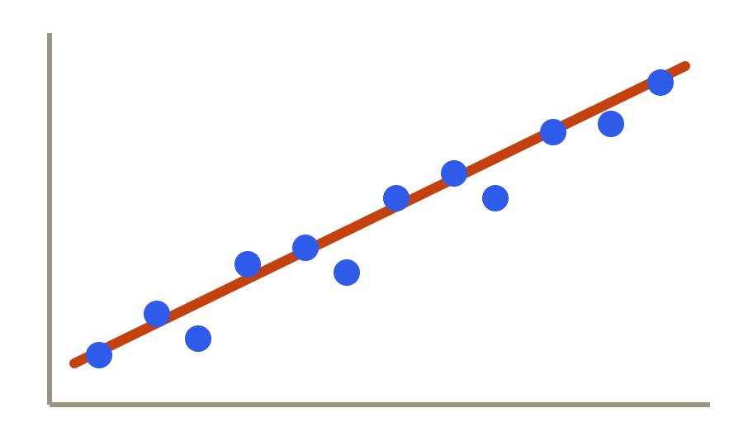
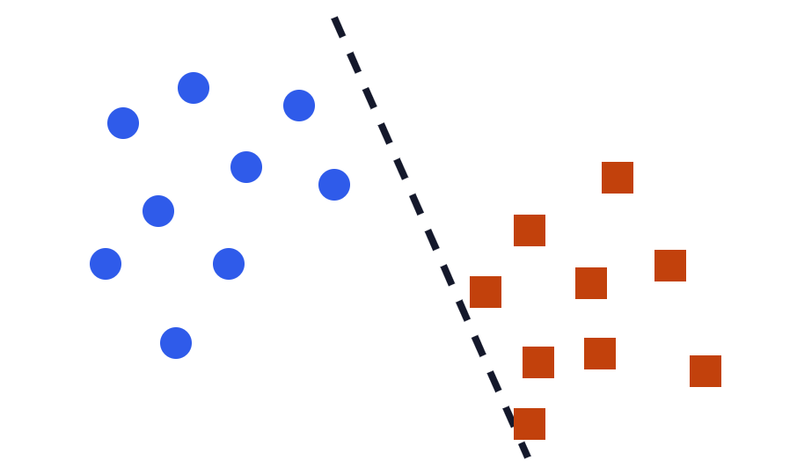
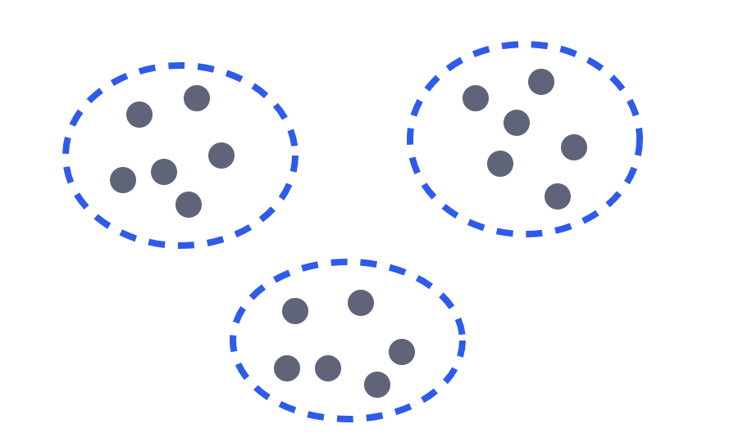
Three kinds of problems
Supervised
Supervised
Unsupervised
Regression
Classification
Clustering
Predict a number
Predict a category
Find groups, no labels
House price, temperature
Spam or not, digit 0–9
Customer segments
Intro to Machine Learning · Weeks 1–2
Notes:
~1.5 min. Walk left to right. Regression: output is a number on a continuous scale; we fit something like a line through the points. Classification: output is one of a fixed set of categories (blue circle or orange square); we learn a boundary between them. Clustering: nobody tells us the groups; the algorithm discovers them. Quick check question for the room: “predict tomorrow’s temperature” (regression), “is this tumor benign or malignant” (classification), “group news articles by topic with no labels” (clustering). Rule of thumb: look at the label column; number = regression, category = classification, no label = clustering.

Slide 11

Learning and inference
LEARNING (TRAINING)
INFERENCE (PREDICTION)
Labeled examples
ML algorithm
Model
New input x
Model
Prediction ŷ
Algorithm ≠ model
Learning = less error
The algorithm is the recipe. The model is the dish it produces.
Training tries to shrink the model’s mistakes on the examples.
Some algorithms improve step by step; kNN simply stores the data
Notes:
~1 min. Two phases, the same picture your lecturer uses. Learning (training): we give an ML algorithm labeled examples (x, y) and it produces a model. Inference (prediction or test time): we give the model a new input x it has never seen and it outputs a prediction y-hat. Highlight the vocabulary: the algorithm is the recipe, the model is the result. Under the hood most algorithms adjust the model step by step so that its errors on the training examples get smaller (that is what “learning” means); some, like kNN, just store the data. The next slide is about how we measure those errors.

Slide 12
Measuring error
Regression
Classification
Careful
Mean squared error
Misclassification rate
Accuracy can lie
mean((y − ŷ)²)
5% of patients have cancer. Always answering “no cancer” is 95% accurate and finds nobody.
mistakes / total
Squared gaps: big misses hurt, errors can’t cancel out
The share of predictions that are wrong
y = true value · ŷ = model’s prediction · Later: confusion matrix, precision, recall
Notes:
~1.5 min. Two basic scores, both “how wrong are we, on average”. Regression: mean squared error, the average of (true value − prediction) squared; squaring stops positive and negative errors from cancelling and punishes big misses. Classification: misclassification rate, the number of mistakes divided by the number of samples (accuracy is 1 minus this). Then the warning from your lecturer’s slides: if only 5% of people tested have cancer, a model that predicts “no cancer” for everybody is 95% accurate yet useless. That is why we also look at the confusion matrix (where the mistakes happen), precision and recall, which come in later lectures. Other things we can evaluate: training time, prediction time, model size.

Slide 13
Do well on data the model has never seen.
THE REAL GOAL
Memorizing the past is not predicting the future.
Notes:
~30 sec. Pause here; this is the central idea of the whole field, called generalization. A model that only works on the examples it was trained on is useless: you could just look the answers up. Everything in the next three slides (splitting data, overfitting, the sweet spot) exists to measure and protect generalization. Analogy: a student who memorizes last year’s exam answers vs. one who understands the material.

Slide 14
Splitting the data
Train
Validation
Test
60%
20%
20%
TRAIN
VALIDATION
TEST
Learn from it
Tune hyperparameters
Final score, once
Like practice problems
Like the real exam
Like a mock exam
Typical ratios: 60/20/20 or 70/15/15 · small dataset? Cross-validation, later
Notes:
~1.5 min. Randomly shuffle and split the rows before doing anything else. Train set: the model learns from these rows. Validation set: we use it while developing to compare models and choose settings (for kNN: the value of k). Test set: locked in a drawer; we look at it once at the very end for an honest estimate of how the model will do on new data. If you tune on the test set, it is no longer a fair exam and your final number is optimistic. Your lecturer calls the training part the “development set” and the held-out part the “validation set”; a hyperparameter (like k in kNN) is a setting we choose using the validation set. When data is small, cross-validation reuses it by rotating k folds; it is in the lecture slides, so only name it here. After choosing settings, retrain on all the training data and evaluate once on the test set. Ratios are conventions, not laws.

Slide 15
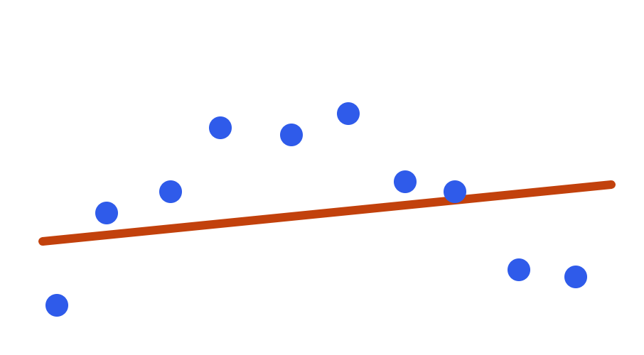
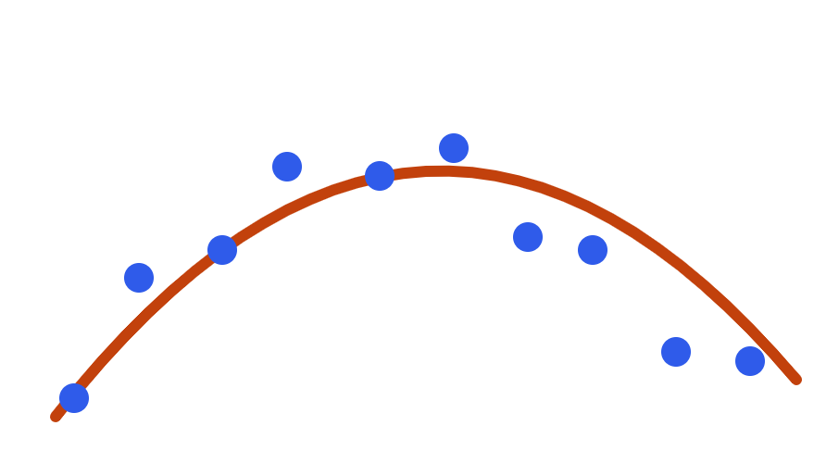
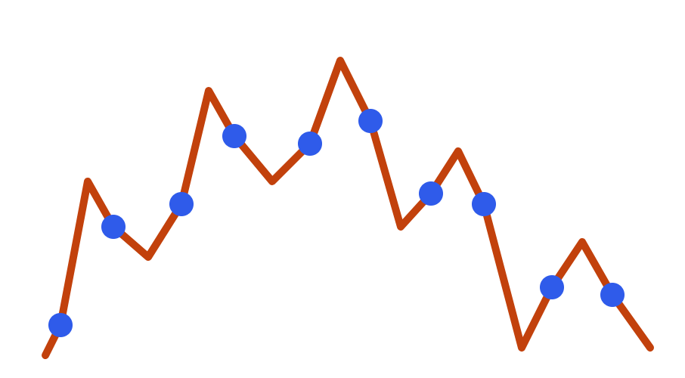
Underfitting and overfitting
Underfit
Good fit
Overfit
Too simple
Follows the trend
Memorizes the noise
Train error: high
Validation error: high
Train error: low
Validation error: low
Train error: tiny
Validation error: high
Blue dots = training data · orange = the model’s fit
Notes:
~1.5 min. Same data in all three panels; only the model’s flexibility changes. Left: too simple, a nearly flat line cannot capture the hump; it is wrong on training data and on new data (underfitting, also called high bias). Middle: the curve captures the trend and ignores the random noise. Right: the zig-zag touches every training point, so training error is almost zero, but it has learned the noise, so new data will be badly predicted (overfitting, high variance). How we detect it: compare training error with validation error. Big gap = overfitting. Both high = underfitting. This is exactly why the validation set exists.

Slide 16
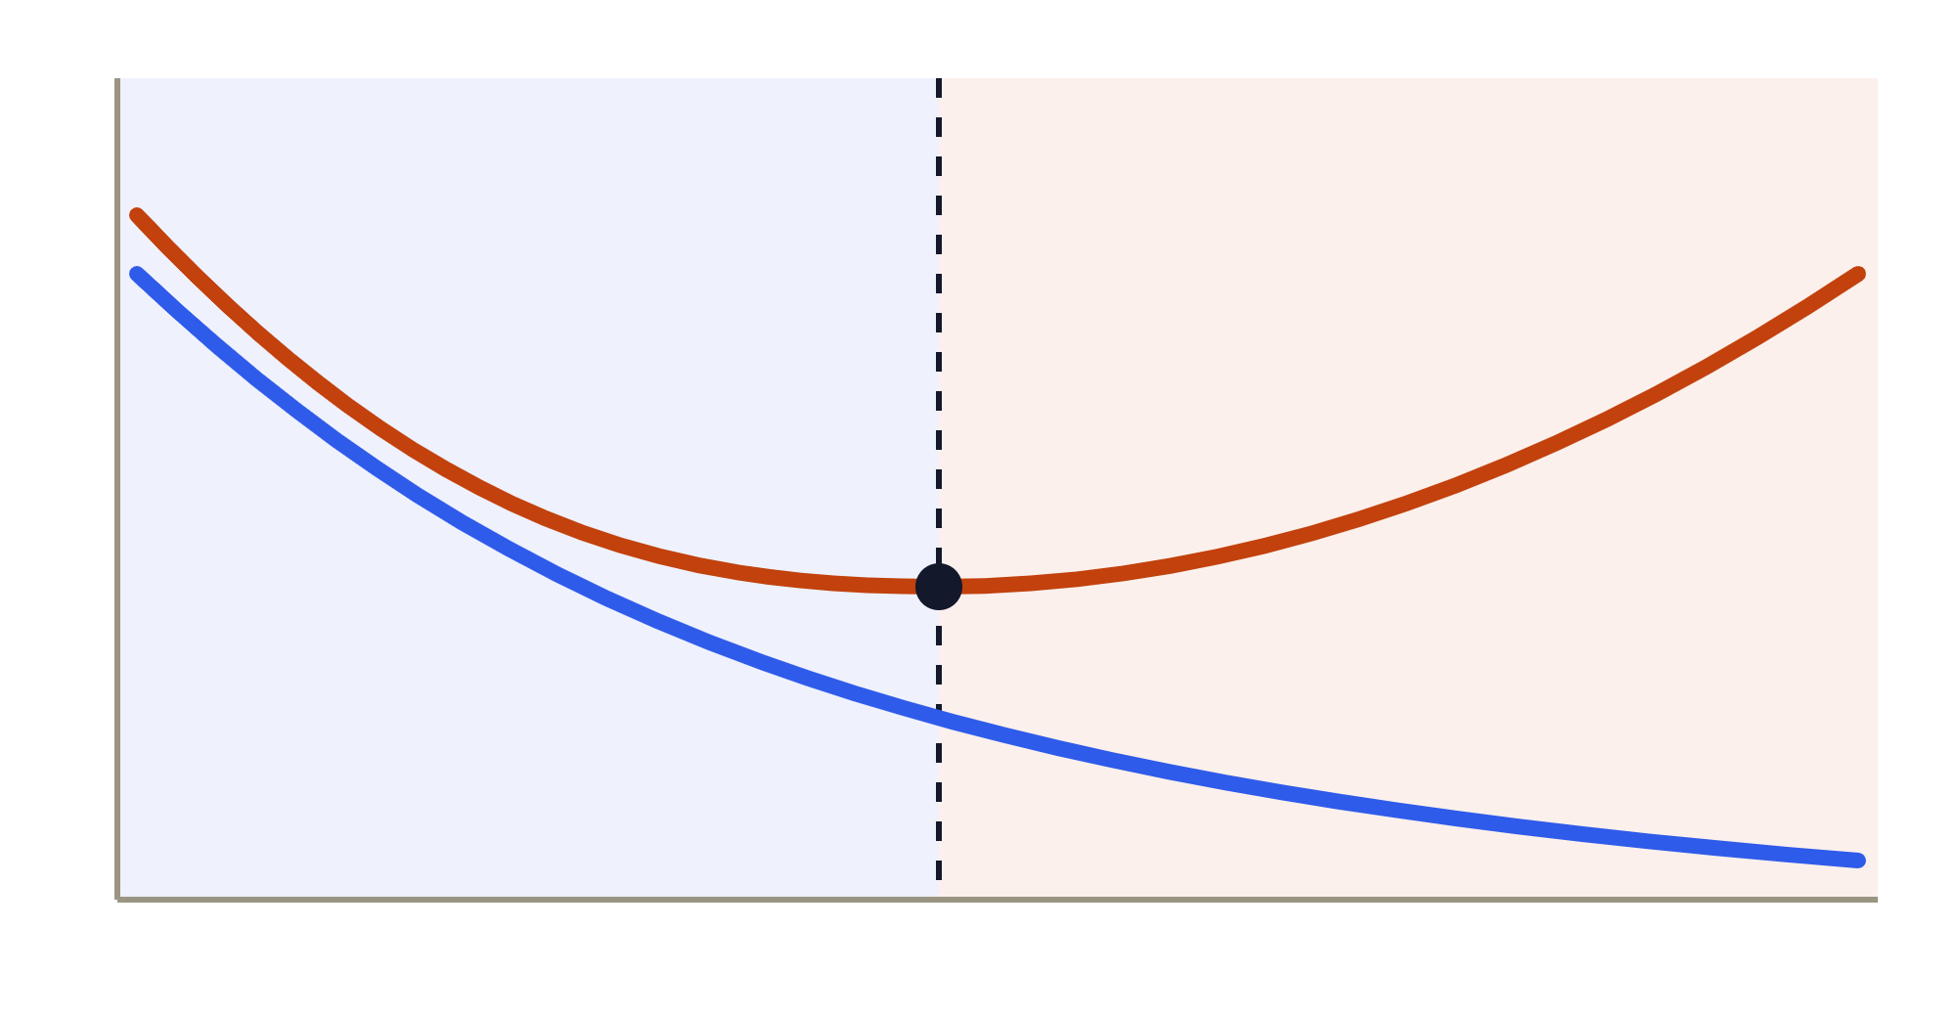
Finding the sweet spot
Underfit
Sweet spot
Overfit
Training error
Validation error
Pick the model with the lowest validation error.
Training error keeps falling, so it can’t warn you.
Model complexity: simple → flexible · vertical axis: error
Intro to Machine Learning · Weeks 1–2
Notes:
~1 min. Make the model more flexible (higher polynomial degree, smaller k in kNN, deeper tree…) and training error always goes down. Validation error goes down at first, then turns around when the model starts to memorize noise. The lowest point of the orange curve is the model we want. This is the standard recipe: try several complexities, compare on validation, pick the best, then report the test score once. In the lab we will see this with kNN: k controls complexity.

Slide 17
Learning by similarity
OUR FIRST ALGORITHM
New in town? Ask people like you, then do what most of them do.
k-Nearest Neighbors lets us see all of these in one small algorithm:
Features
Labels
Distance
The value of k
Train / validation
Overfitting
Notes:
~1 min. Transition slide. Say: so far we talked about what ML is and how we measure it; now let’s meet one concrete algorithm. Analogy: you are new in town and need a restaurant, so you ask the people most similar to you and copy what most of them chose. kNN does exactly this with data: to label a new example, find the most similar labeled examples and let them vote. Why we start here: you can understand it without any math, and it touches every idea from today (features, labels, distance, a hyperparameter k, validation, overfitting). Next slide draws it, then we code it.

Slide 18
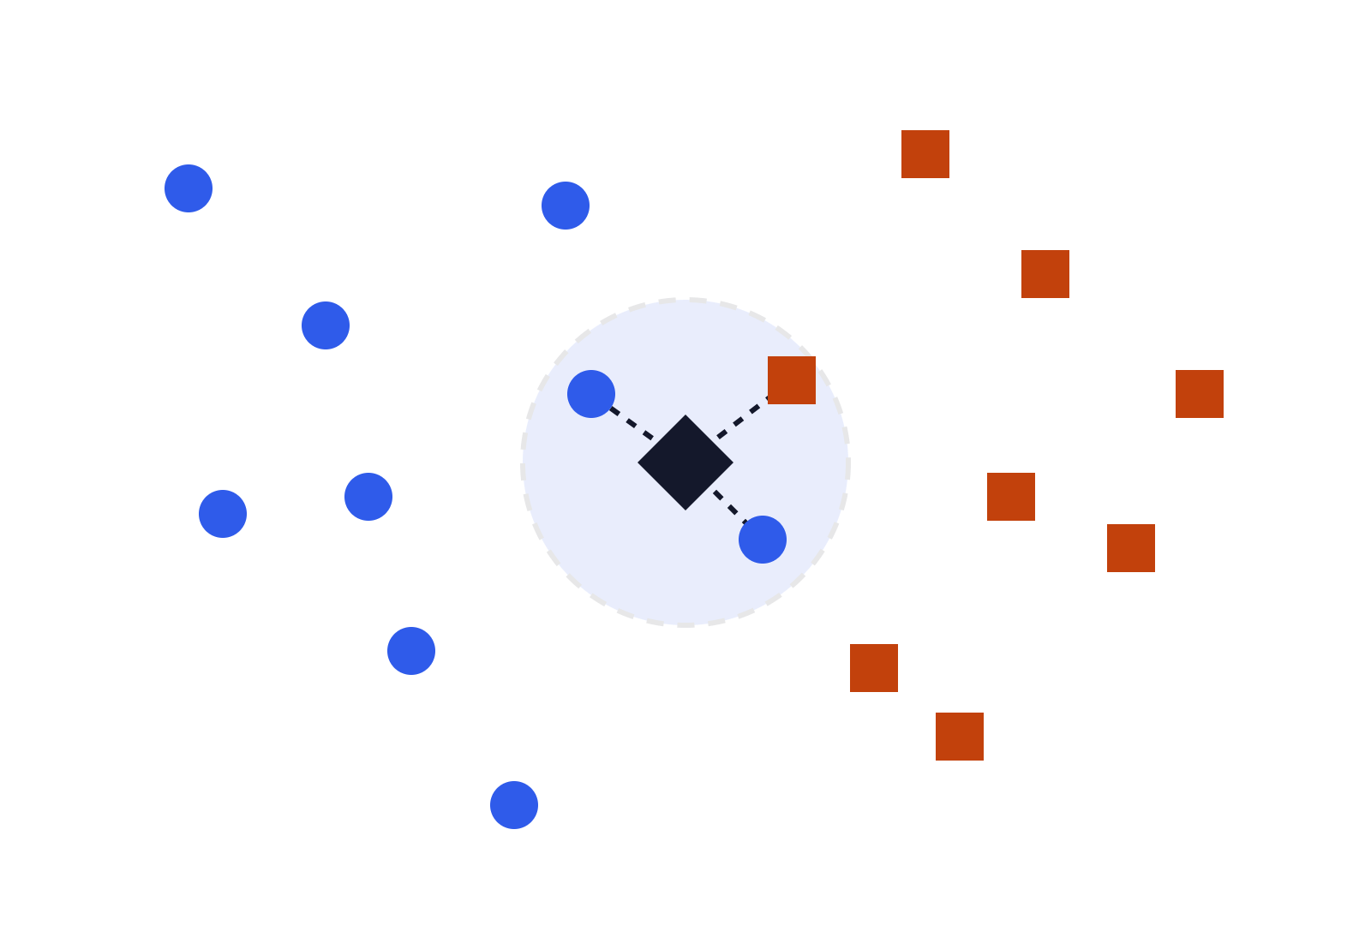

k-Nearest Neighbors
1
Pick k, the number of voters
2
Measure distance to every training point
3
Take the k closest
4
Vote for a class, or average for a number
Class A
Class B
New point: k = 3, so 2 A + 1 B, predict A
“Training” is just storing the data; all the work happens at prediction time
Notes:
~1.5 min. The simplest ML algorithm: to predict for a new point, look at the k training points closest to it and let them vote. In the picture the black diamond has three nearest neighbors, two blue circles and one orange square, so we predict blue (class A). For regression, average the neighbors’ labels instead of voting. Notice there is almost no “training”: kNN just stores the training data and does the work at prediction time (a “lazy learner”). “Closest” needs a distance; usually Euclidean (straight-line) distance on the features. Do the walk-through with the picture, then ask: what changes if k = 1? What if k = 9? (Next slide.)

Slide 19
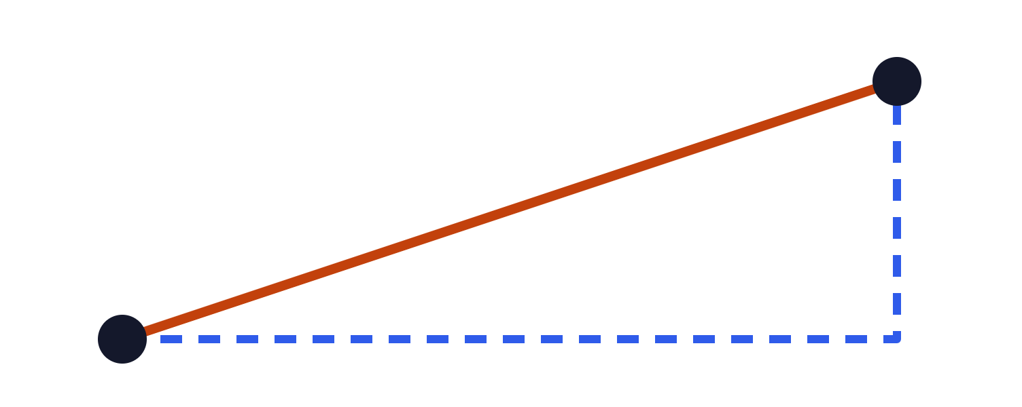
Measuring closeness
EXAMPLE: TWO PEOPLE
A: 170 cm, 65 kg
B: 175 cm, 68 kg
Euclidean = √(5² + 3²) ≈ 5.8
Manhattan = 5 + 3 = 8
Euclidean: the straight line
d = √((a₁−b₁)² + (a₂−b₂)²)
Smaller distance = more similar
Manhattan: along the grid
d = |a₁−b₁| + |a₂−b₂|
Other distances exist: Hamming for categories, edit distance for text
Notes:
~1 min. “Nearest” needs a number that says how different two examples are: a distance. Euclidean is the straight-line distance and is the usual default. Manhattan adds up the differences feature by feature, like walking along city blocks. Worked example: two people described by height and weight; the gaps are 5 cm and 3 kg, so Euclidean = sqrt(25 + 9) = about 5.8 and Manhattan = 8. Both say the same thing: smaller = more similar. Your lecturer’s slides also show Hamming distance (count how many categorical features differ) and edit distance for strings; one sentence is enough here. The choice of distance is one of the three big kNN decisions (value of k, distance, voting).

Slide 20
kNN: choices and caveats
SMALL K
LARGE K
JUST RIGHT
Flexible, noisy
Smooth, blurry
Tune k
k = 1 copies its closest neighbor. Risk: overfitting.
k = all always votes for the majority. Risk: underfitting.
Try 1, 3, 5, 7… and compare on the validation set.
Watch out for
Good to know
Feature scales
Slow predictions on big data
Noisy or many features
Regression: average the k labels
Closer neighbors can vote louder
Odd k avoids tied votes
k is a hyperparameter: we choose it, the algorithm doesn’t learn it
Notes:
~1.5 min. k is the complexity knob, connecting back to overfitting. k = 1: every training point is its own island, the decision boundary is jagged and follows the noise (your lecturer shows k=1 vs k=7 pictures). Very large k: the prediction is dominated by the overall majority class, which is too simple. We choose k on the validation set: vary k, watch the validation error, pick the best. Watch out for: (1) feature scales, just seen; (2) kNN stores all training data and compares a new point with every one of them, so predictions get slow on big datasets; (3) noisy or many features make “closeness” less meaningful (curse of dimensionality). Good to know: for regression, kNN averages the neighbors’ labels instead of voting; the vote can be weighted by distance (for example 1/d²); an odd k avoids ties with two classes. Pros: simple, intuitive, easy to implement. Term to introduce: a hyperparameter is a setting chosen by us before training (also called a meta-parameter).

Slide 21
k-NN Coding
1 · Load the data
2 · Split it
3 · Train kNN
4 · Measure error
5 · Try different k
Python · scikit-learn · matplotlib
Notes:
~15 min of live code, then come back for the recap slide. Suggested flow (edit to your notebook): load a small dataset into a table and look at the features and label; split into train/validation/test; fit a kNN classifier; compute accuracy on train and validation; loop over k = 1, 3, 5, … and plot train vs. validation accuracy to see underfitting and overfitting live; show what happens without scaling the features; finish by scoring the chosen k on the test set once. Keep the code short and re-runnable so students can follow along. Dataset idea: MNIST digits tie in with the homeworks (flatten the 28 x 28 images into 784 features), or a small table like the house-price example.

Slide 22
Takeaways
1
ML learns rules from data
2
Features in, label out
3
Number: regression. Category: classification. No label: clustering
4
Train, validate, test: never peek at the test set
5
Overfitting is the enemy; aim to generalize
6
kNN: the k closest examples vote. Scale your features
Questions?
Your model is only as good as your data: garbage in, garbage out
Notes:
~1 min, after the live coding. Read the six points quickly and tie each to something they just saw in code. Add the one thing students most often forget: a model is only as good as its data. Biased or sloppy data gives biased or sloppy predictions, so always ask where the data came from. Then open for questions and say what comes next in the course.

